Slide 1


Slide 2


Slide 3


Slide 4


Slide 5
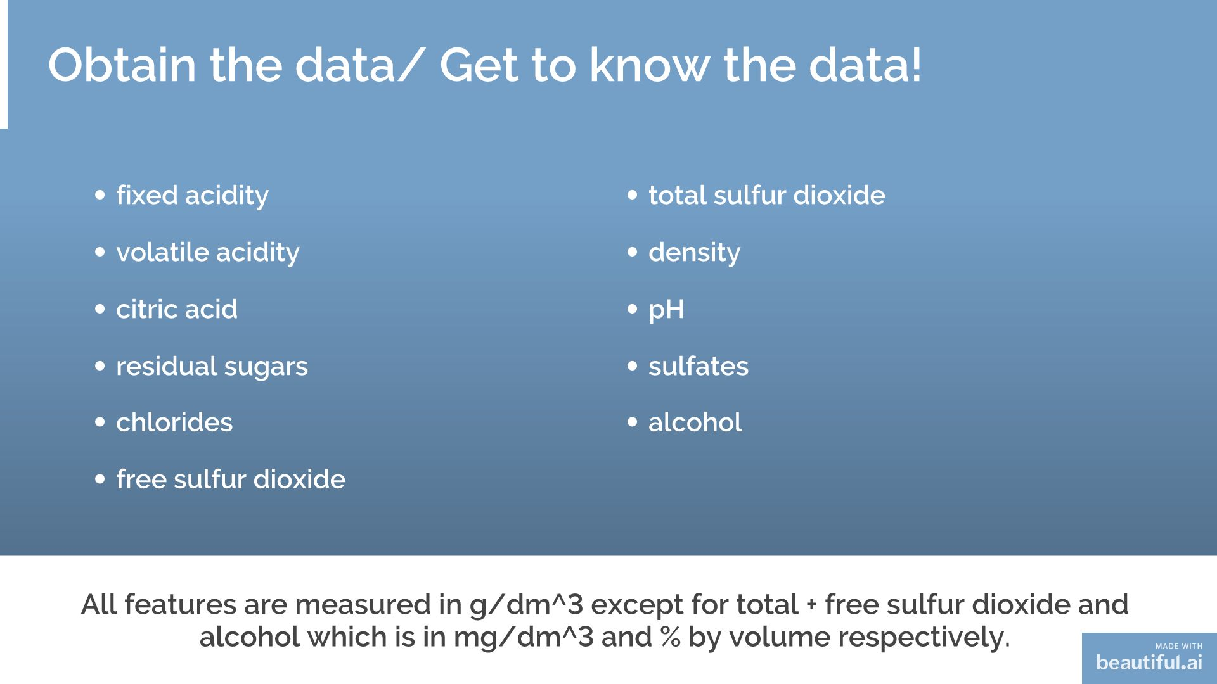

Slide 6


Slide 7
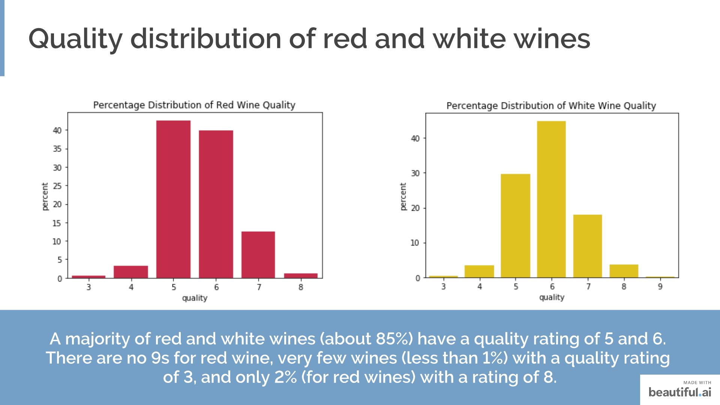

Slide 8
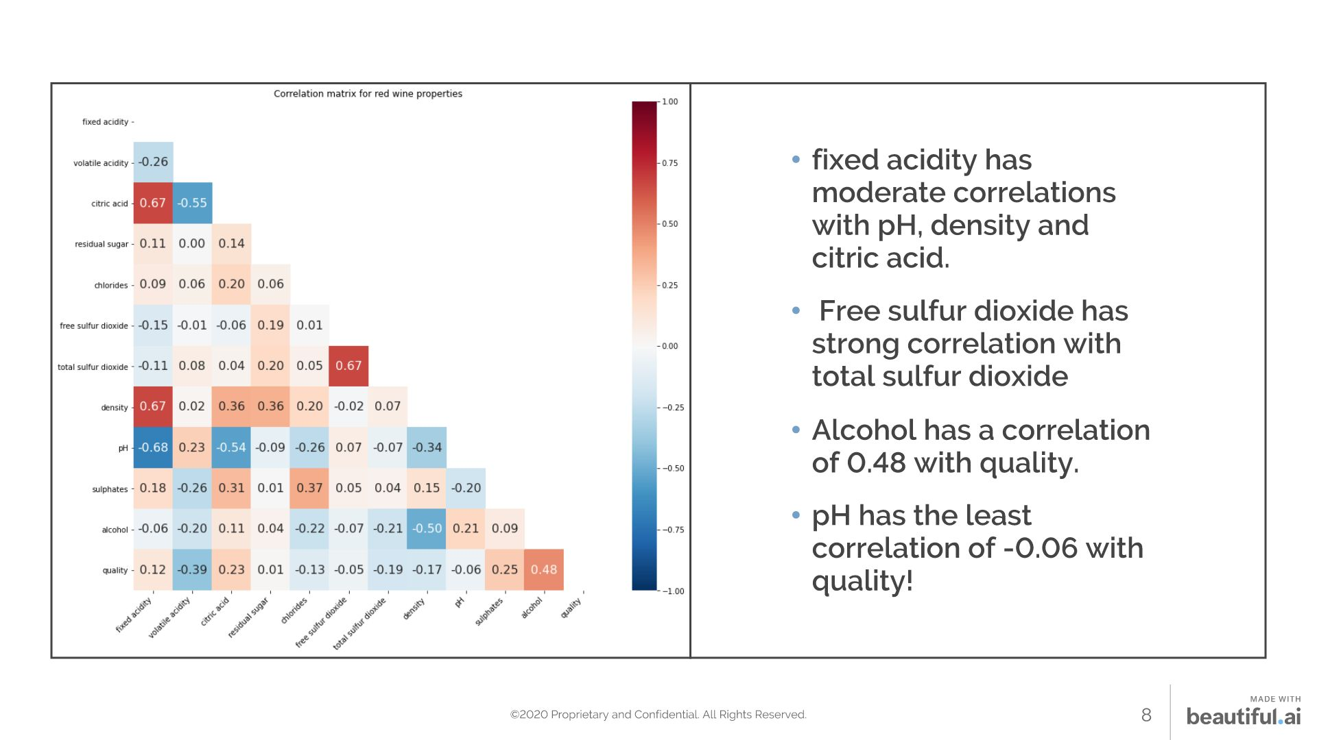

Slide 9
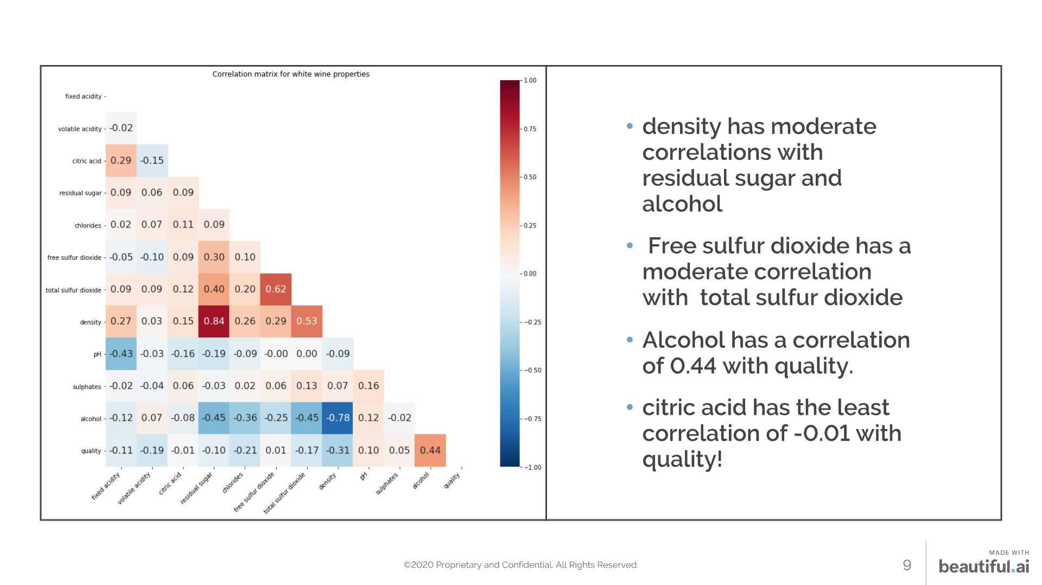

Slide 10
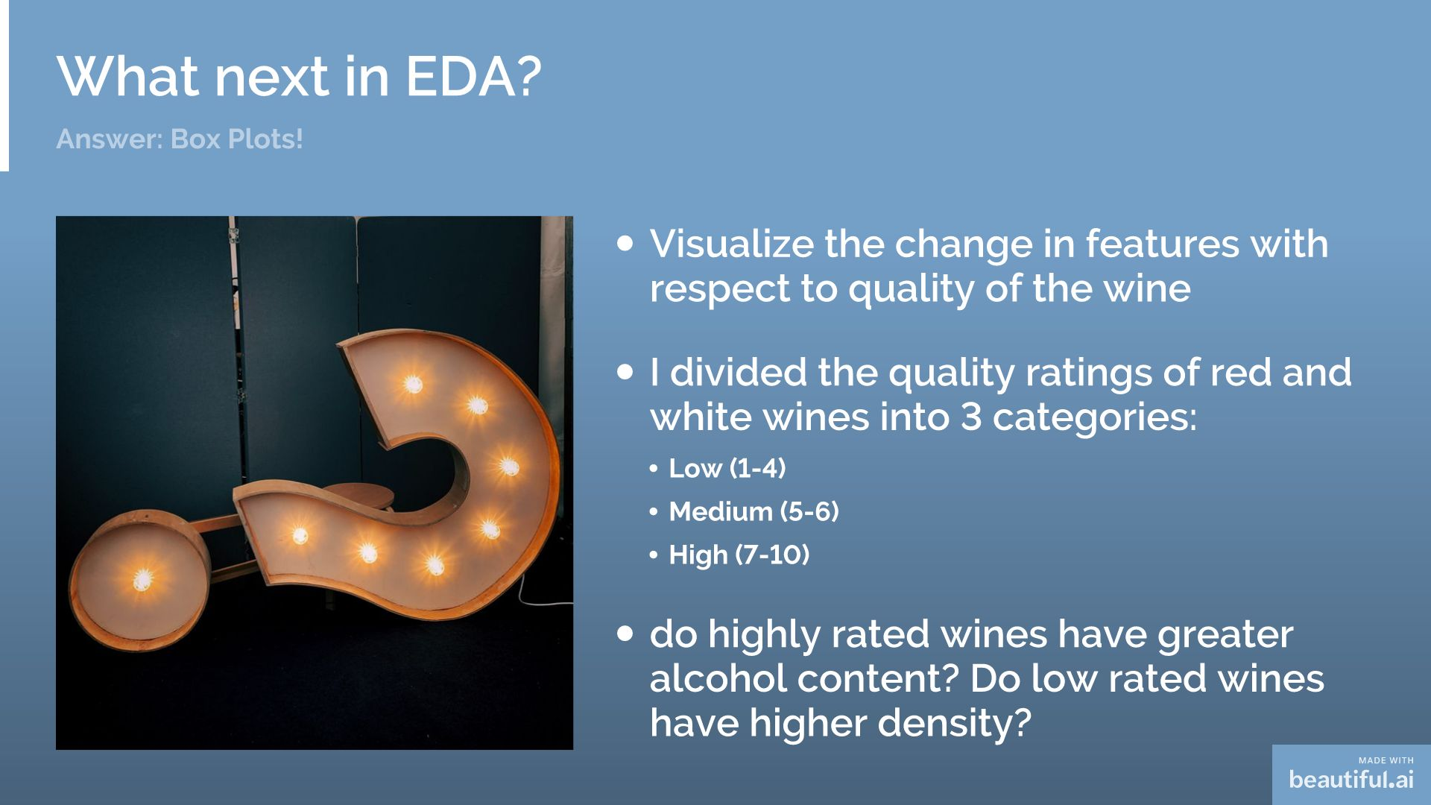

Slide 11
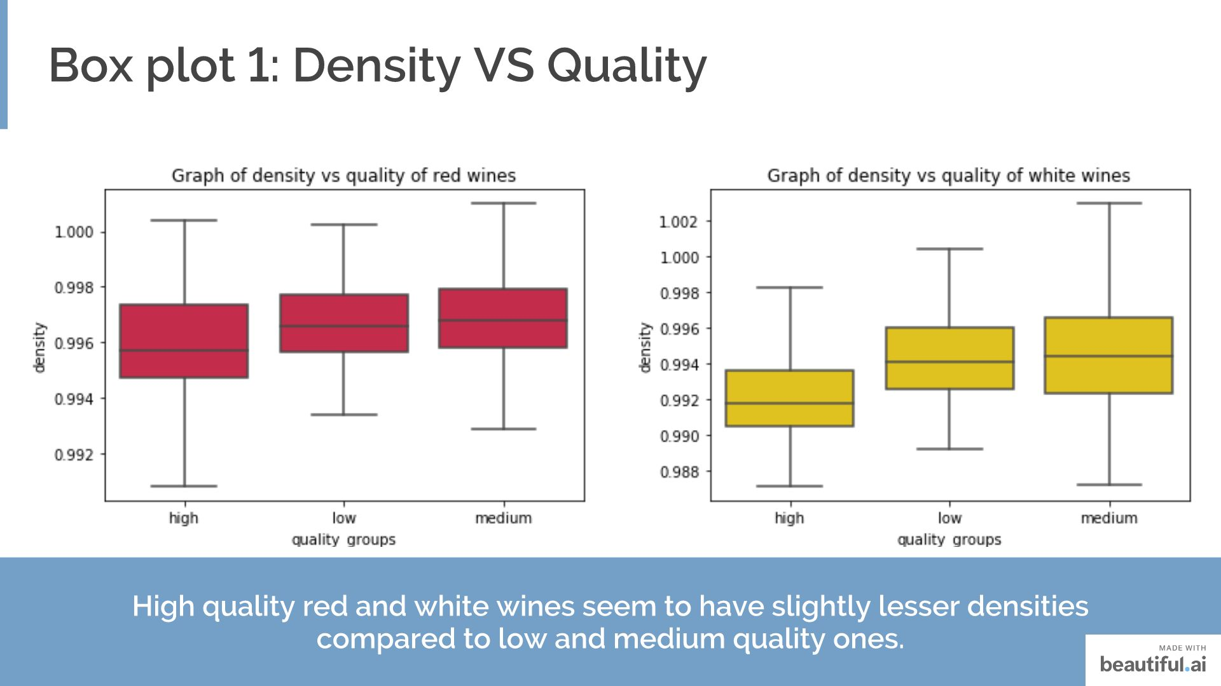

Slide 12
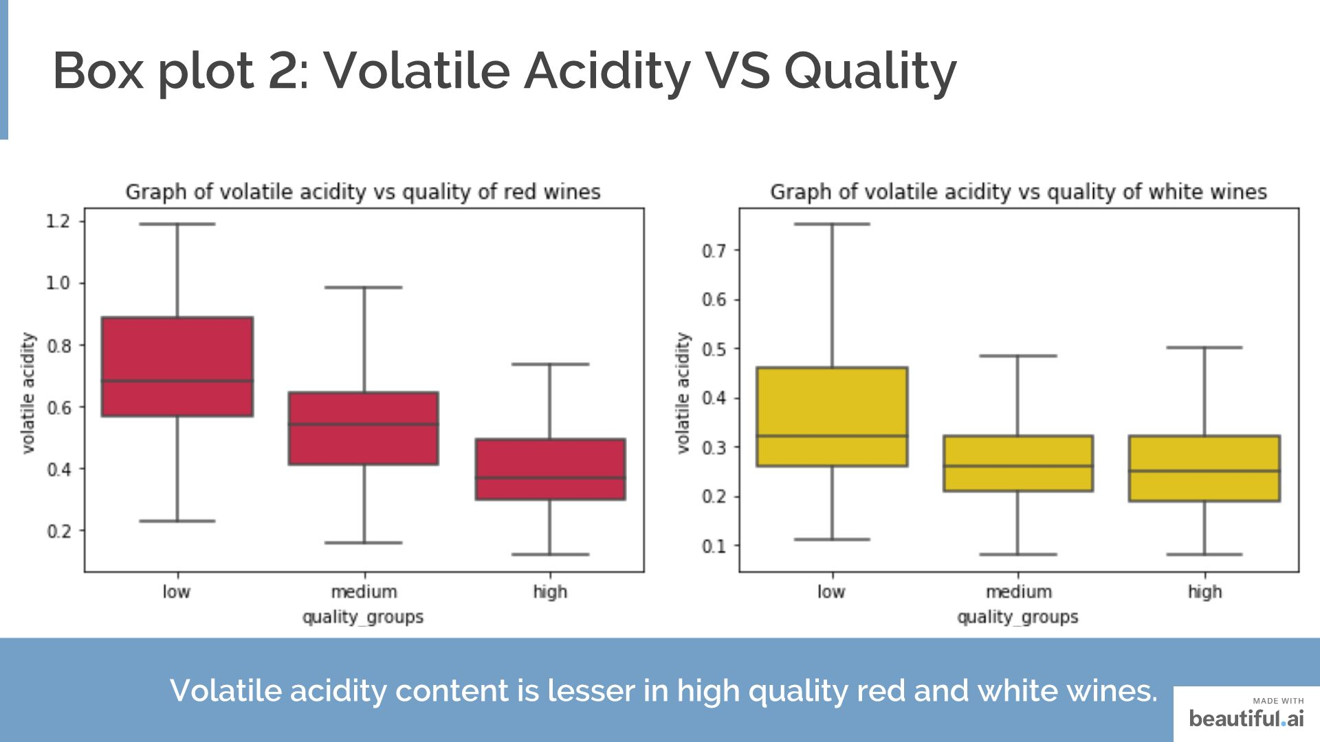
Notes:
Volatile acidity could be an indicator of spoilage, or errors in the manufacturing processes — caused by things like damaged grapes or wine exposed to air. This causes acetic acid bacteria to enter and thrive, and give rise to unpleasant tastes and smells. It is reasonable to see that volatile acidity content is lesser in high quality red wines. It is most in low quality red wines.

Slide 13
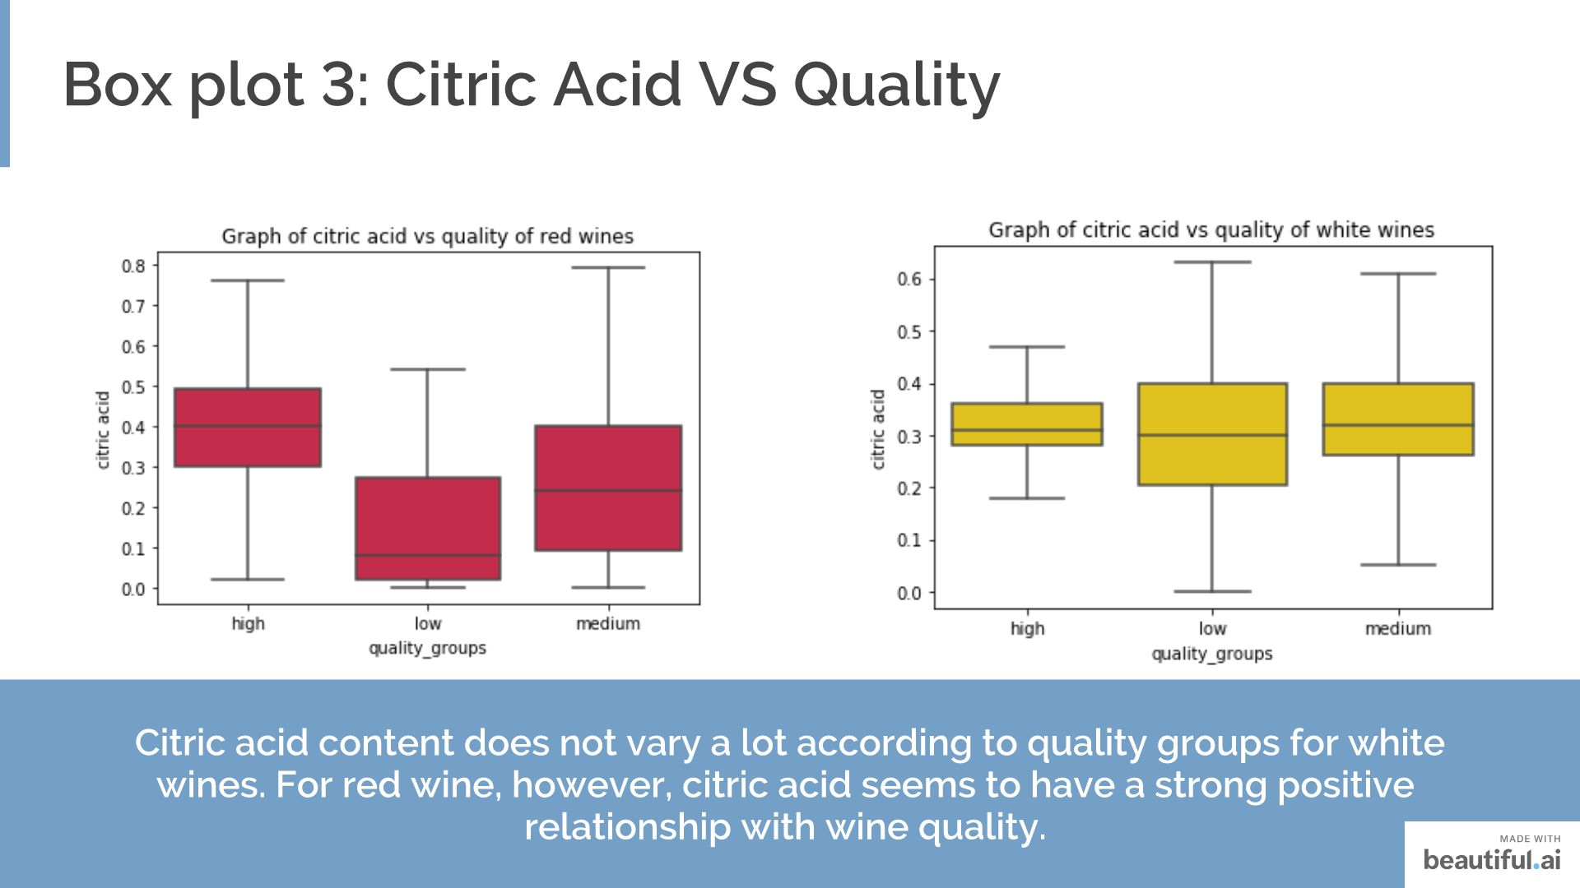
Notes:
Citric acid is generally found in very small quantities in wine grapes. It acts as a preservative and is added to wines to increase acidity, complement a specific flavor or prevent ferric hazes. Citric acid content seems to be slightly higher in high quality red wines. It can be added to finished wines to increase acidity and give a “fresh” flavor.

Slide 14
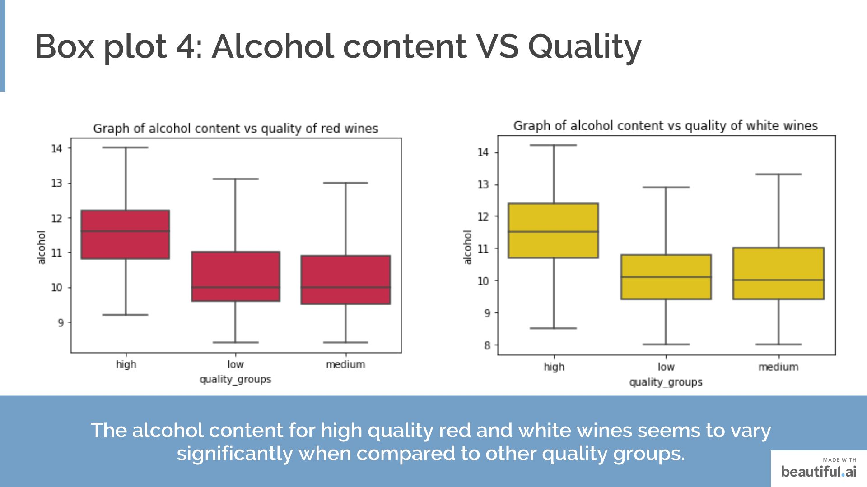
Notes:
Alcohol produces a desirable psychedelic effect that many find enjoyable in their wine. Too much can have undesirable side effects.

Slide 15
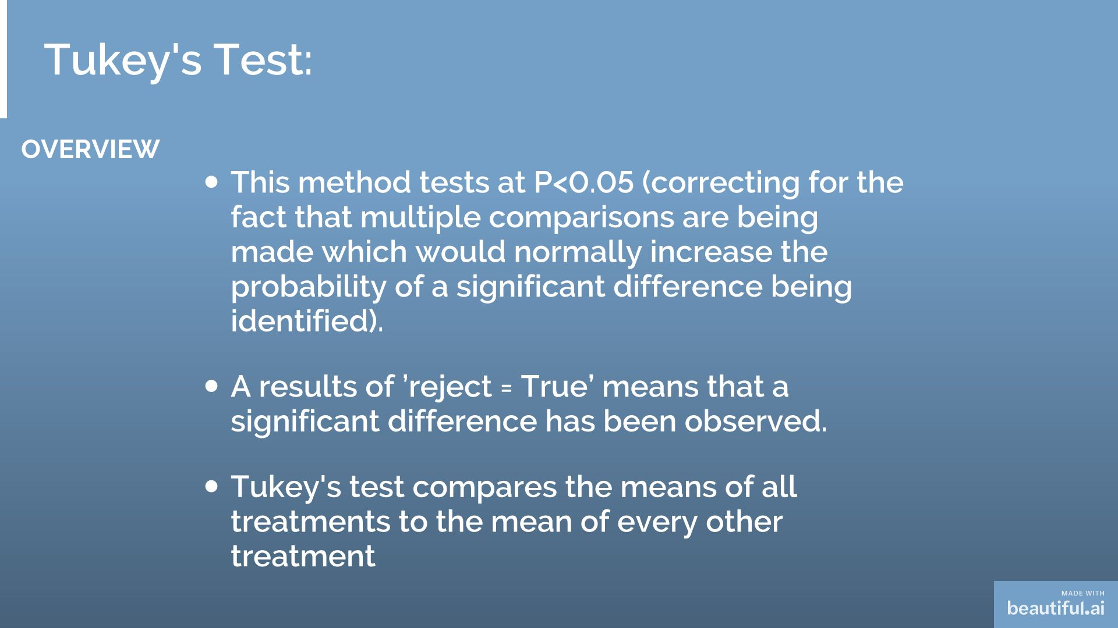

Slide 16
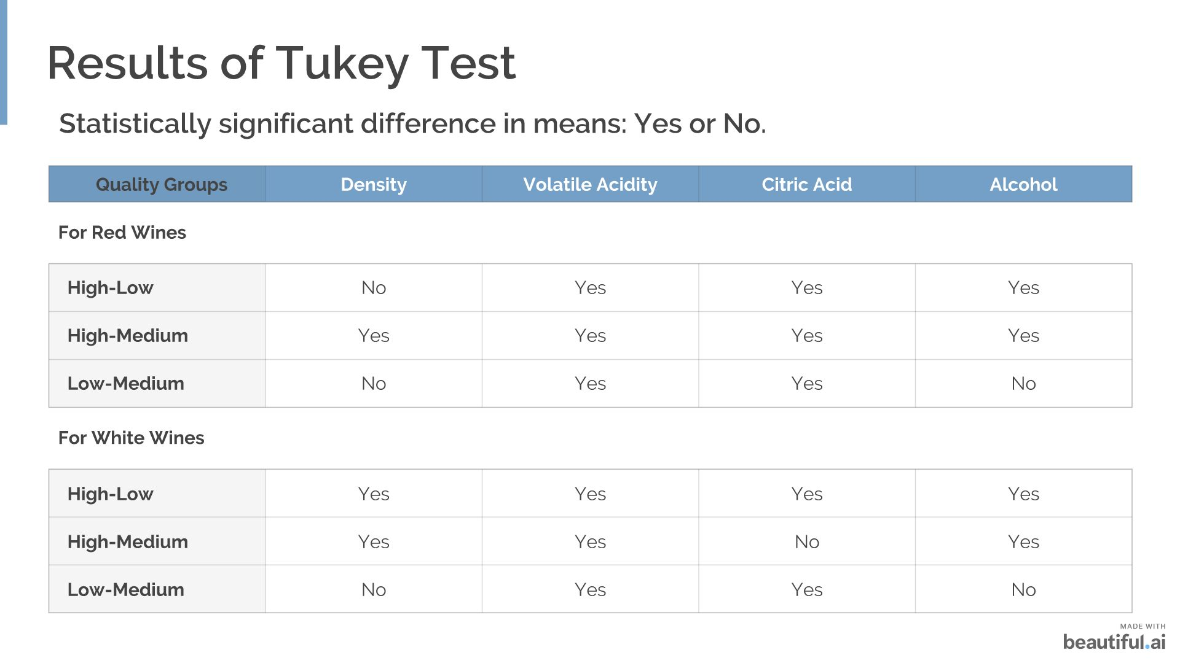

Slide 17
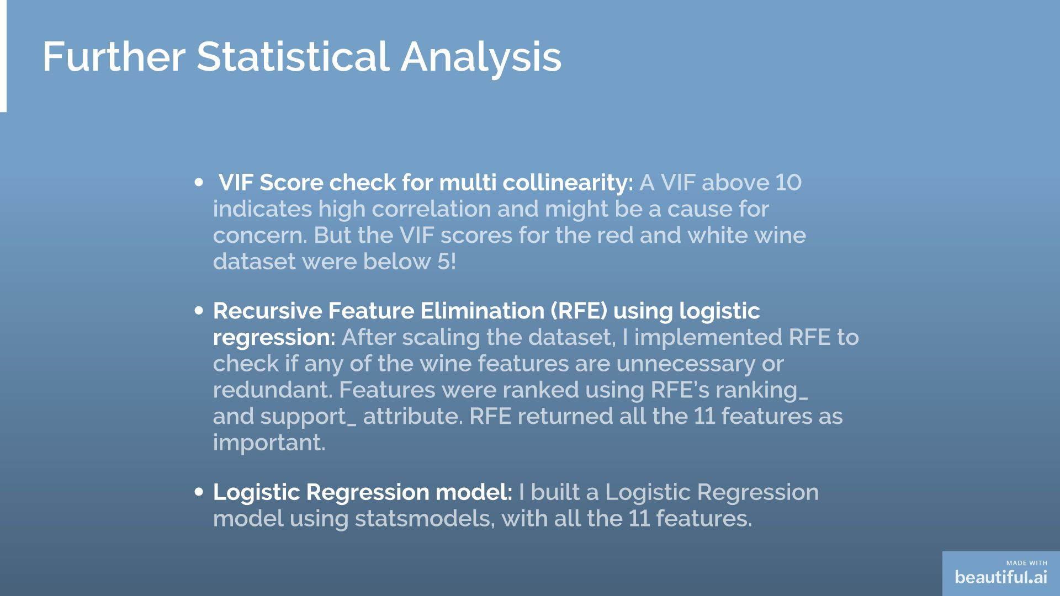

Slide 18
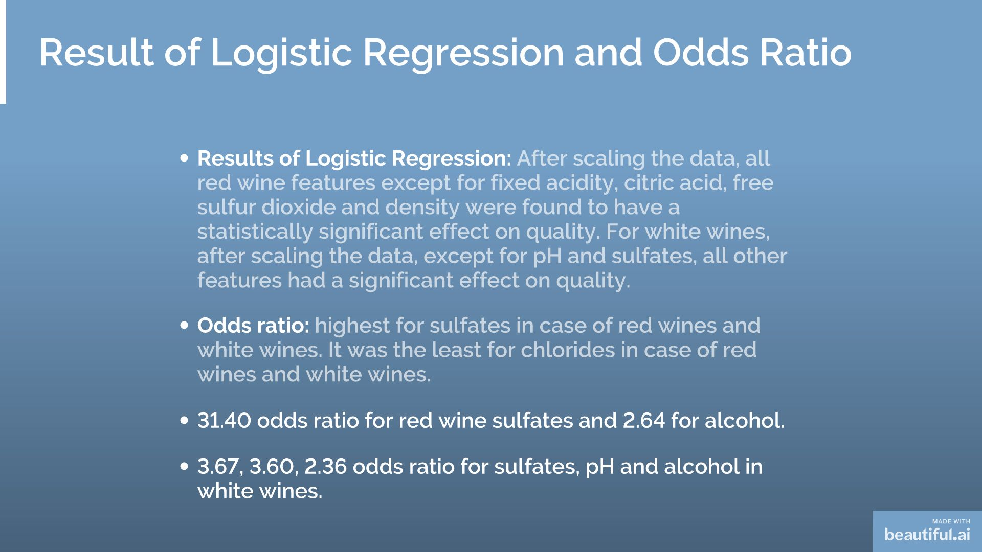

Slide 19


Slide 20
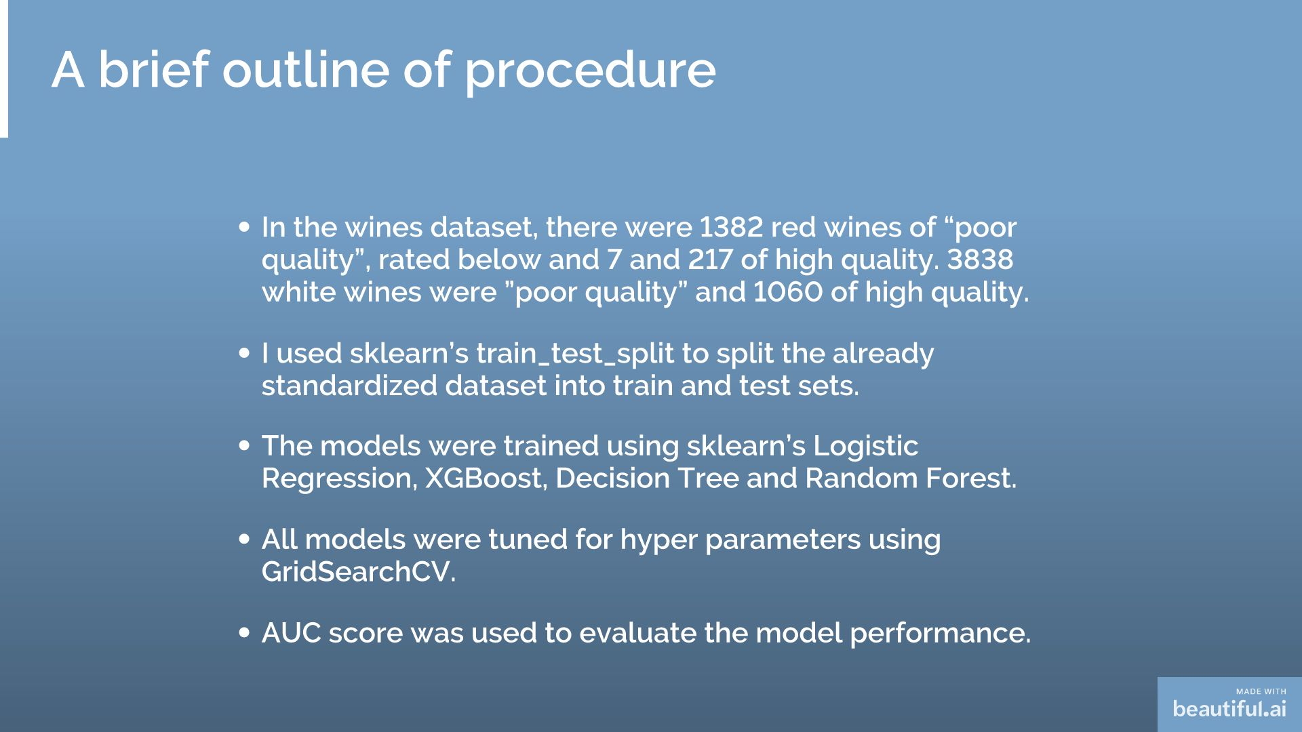

Slide 21
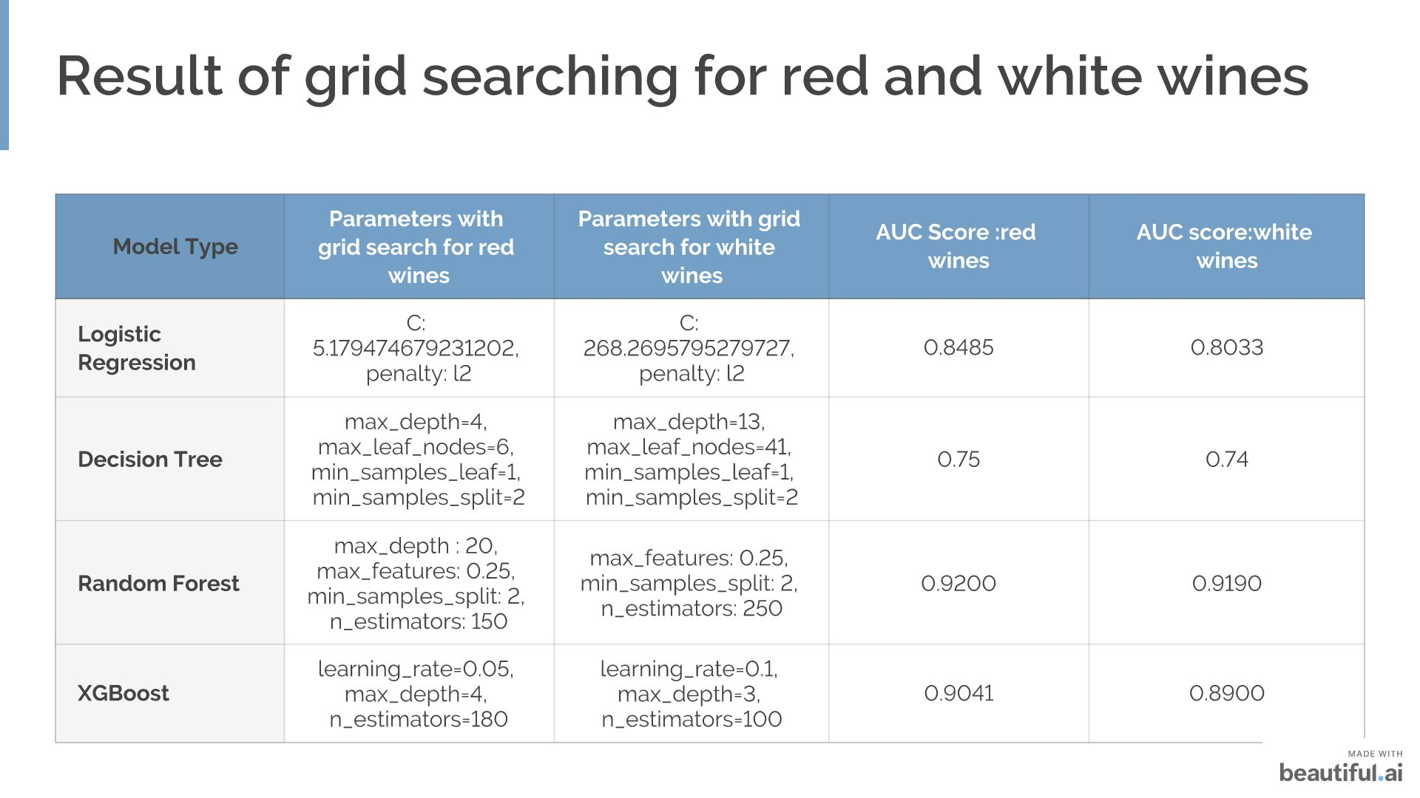

Slide 22
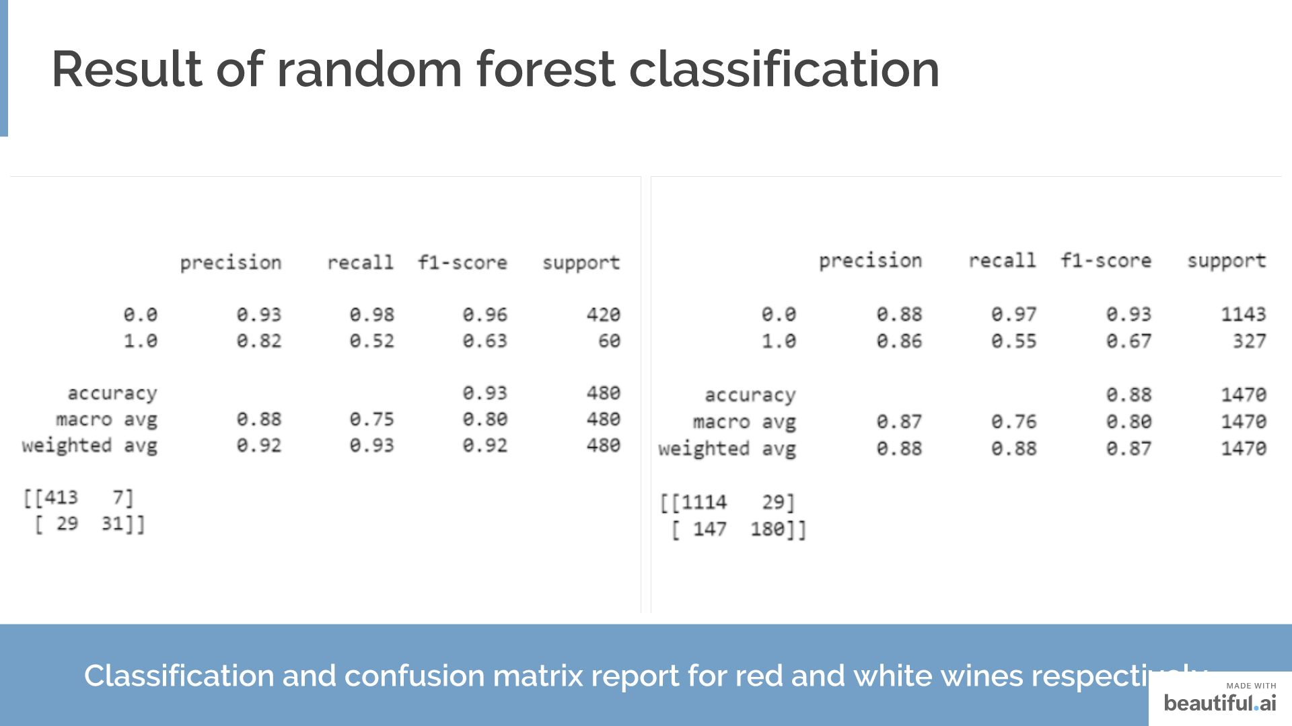

Slide 23
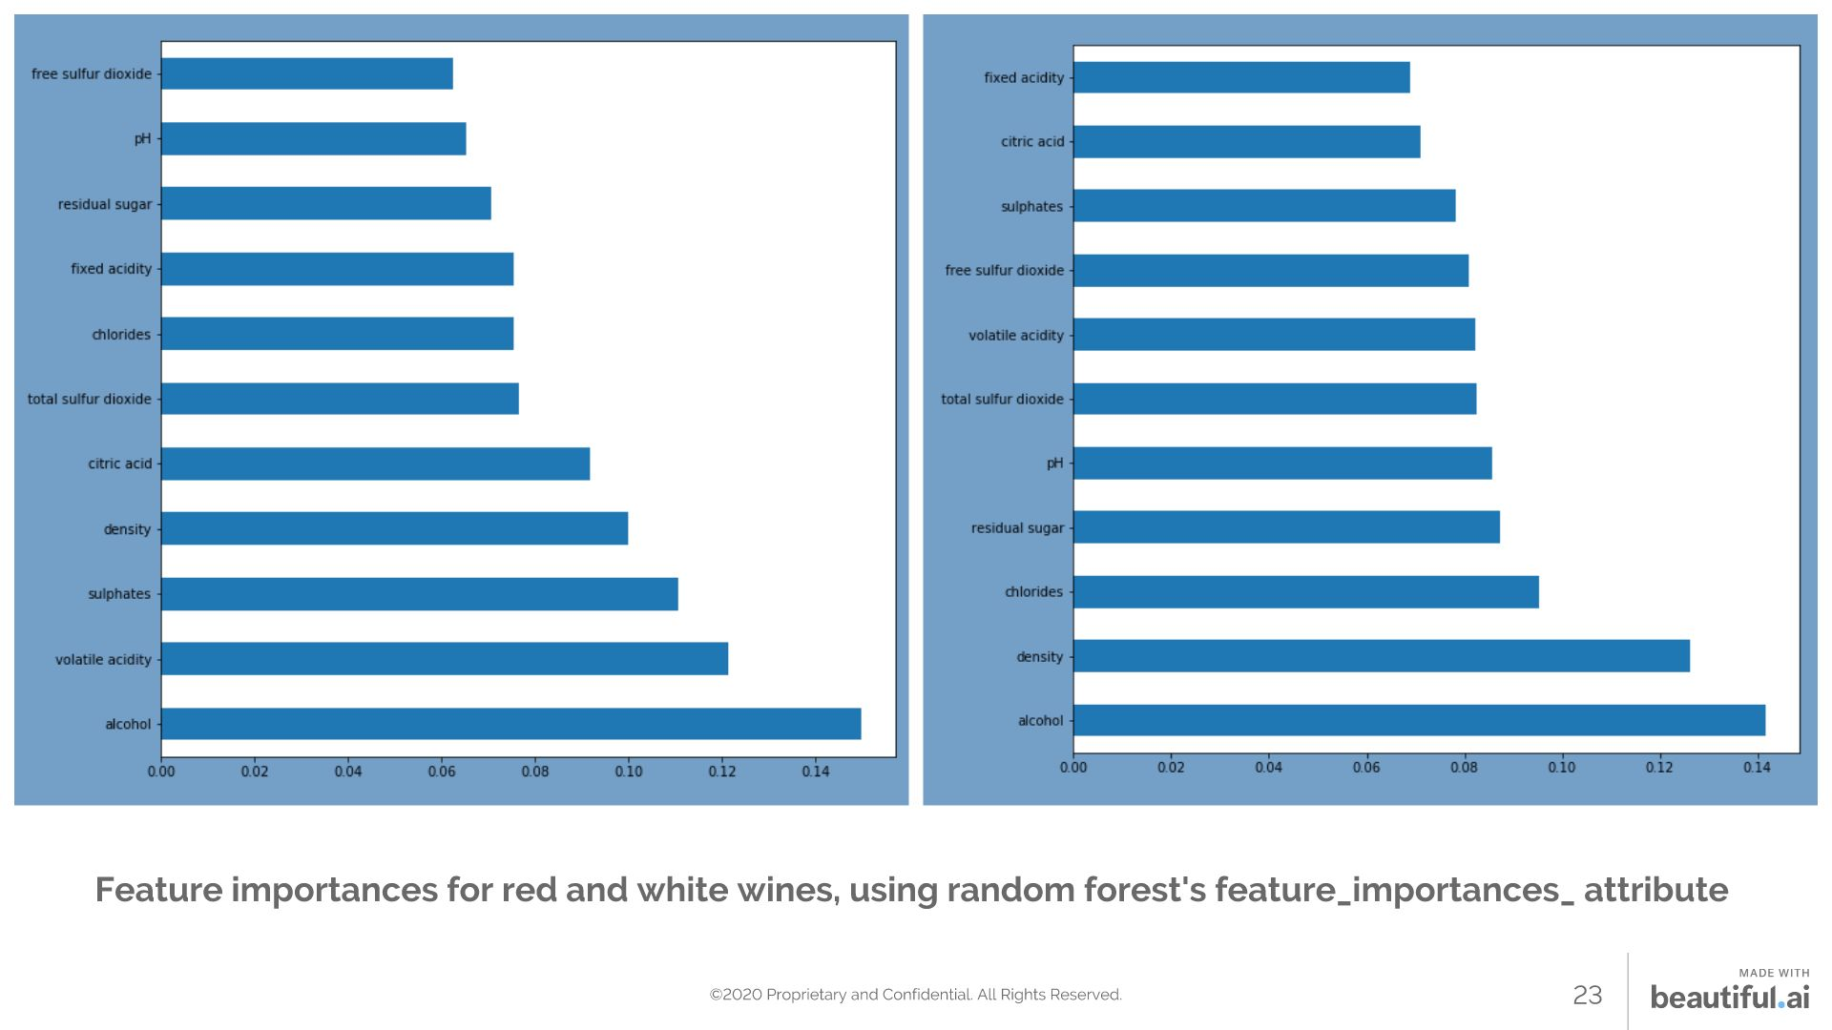

Slide 24
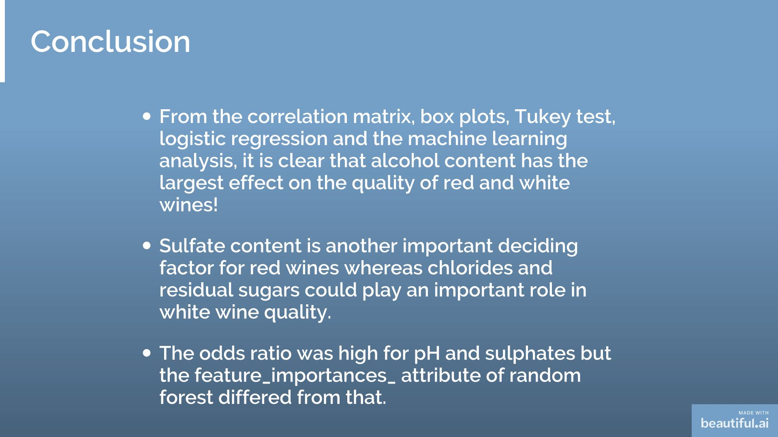

Slide 25


Slide 26


